Slide 1
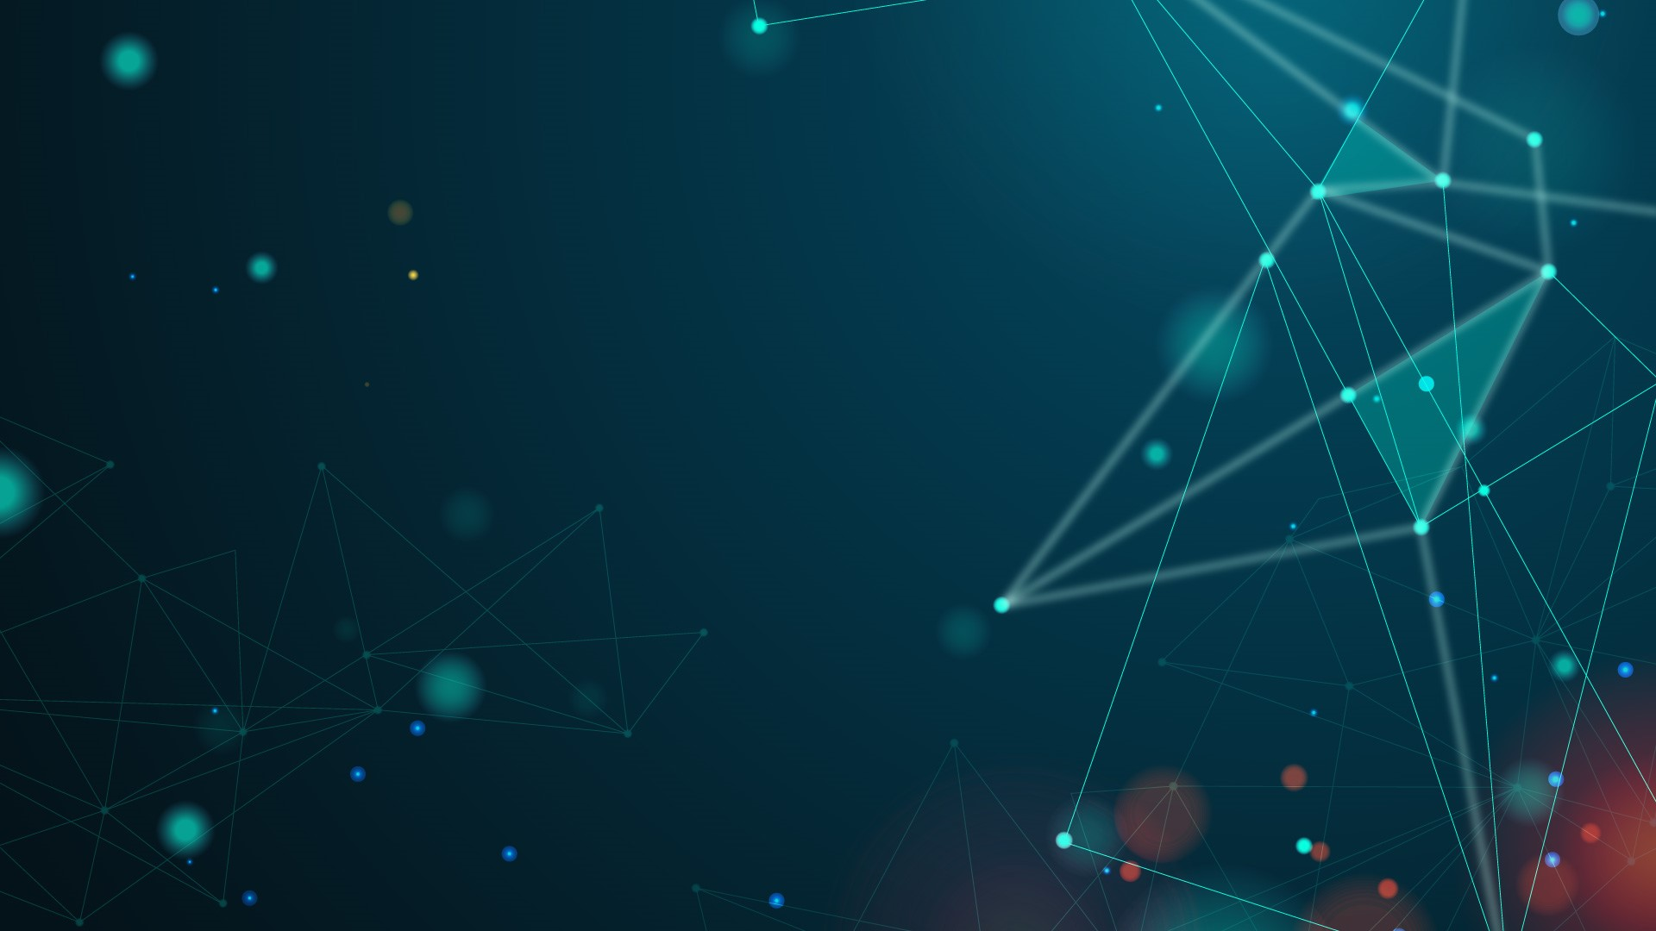
AI TECH AGENCY
Here is where your presentation begins

Slide 2
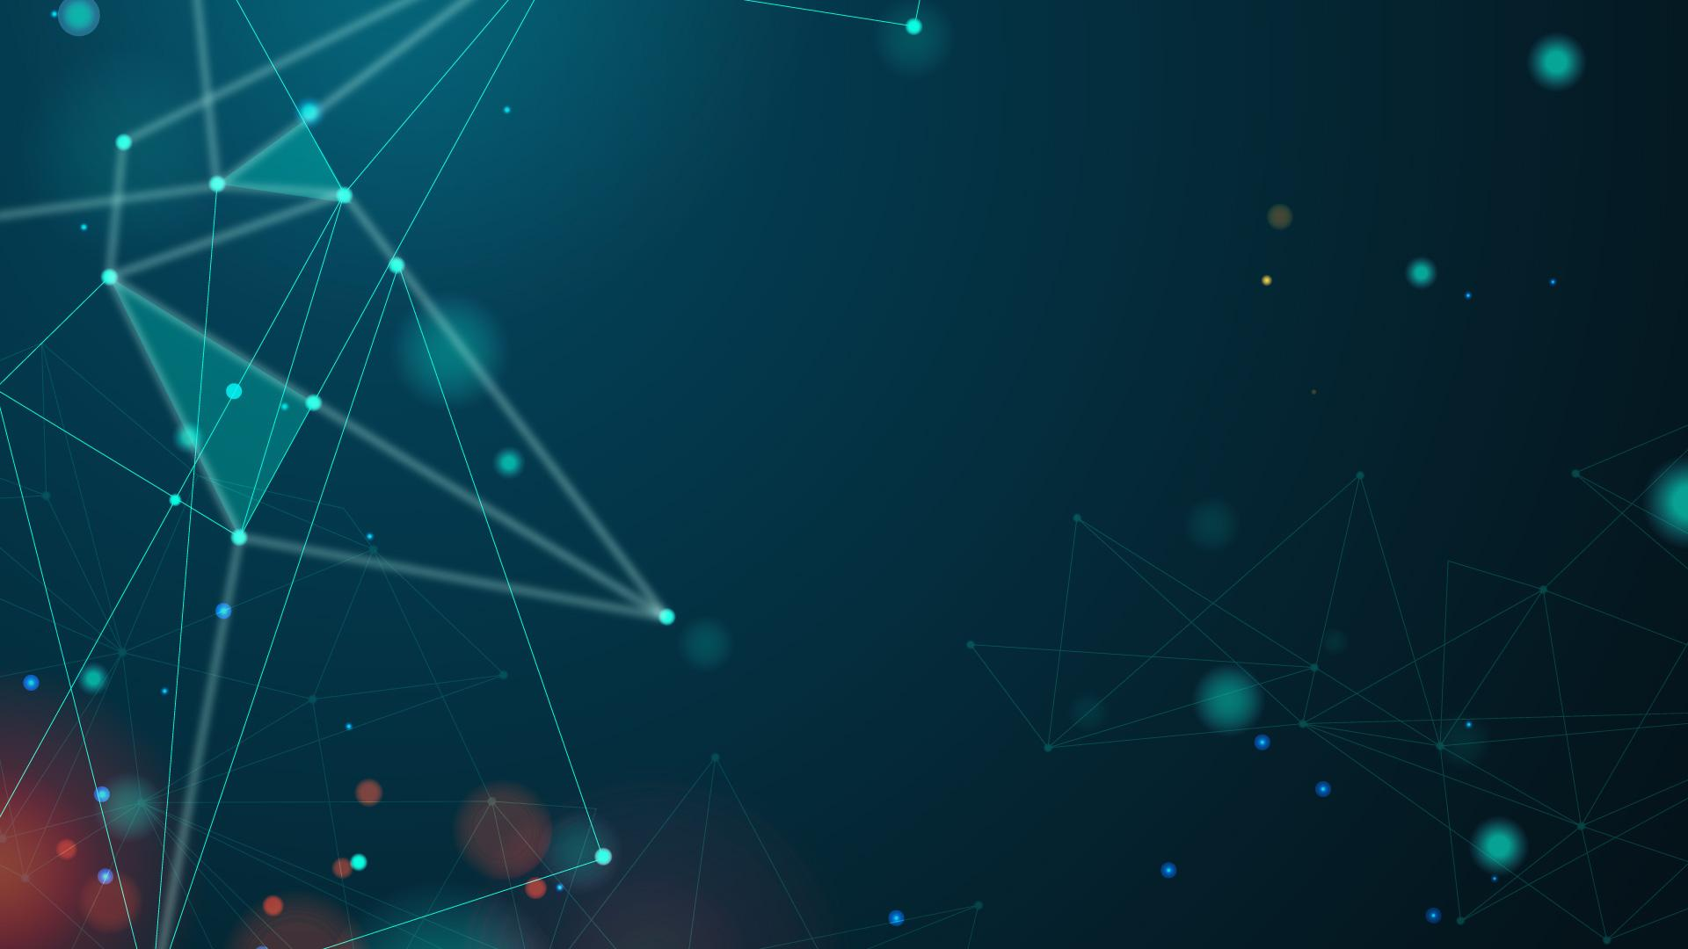
CONTENTS OF THIS TEMPLATE
You can delete this slide when you’re done editing the presentation
Fonts | To view this template correctly in PowerPoint, download and install the fonts we used
Used and alternative resources | An assortment of graphic resources that are suitable for use in this presentation
Thanks slide | You must keep it so that proper credits for our design are given
Colors | All the colors used in this presentation
Icons and infographic resources | These can be used in the template, and their size and color can be edited
Editable presentation theme | You can edit the master slides easily. For more info, click here
For more info: SLIDESGO | BLOG | FAQs
You can visit our sister projects: FREEPIK | FLATICON | STORYSET | WEPIK | VIDEVO

Slide 3
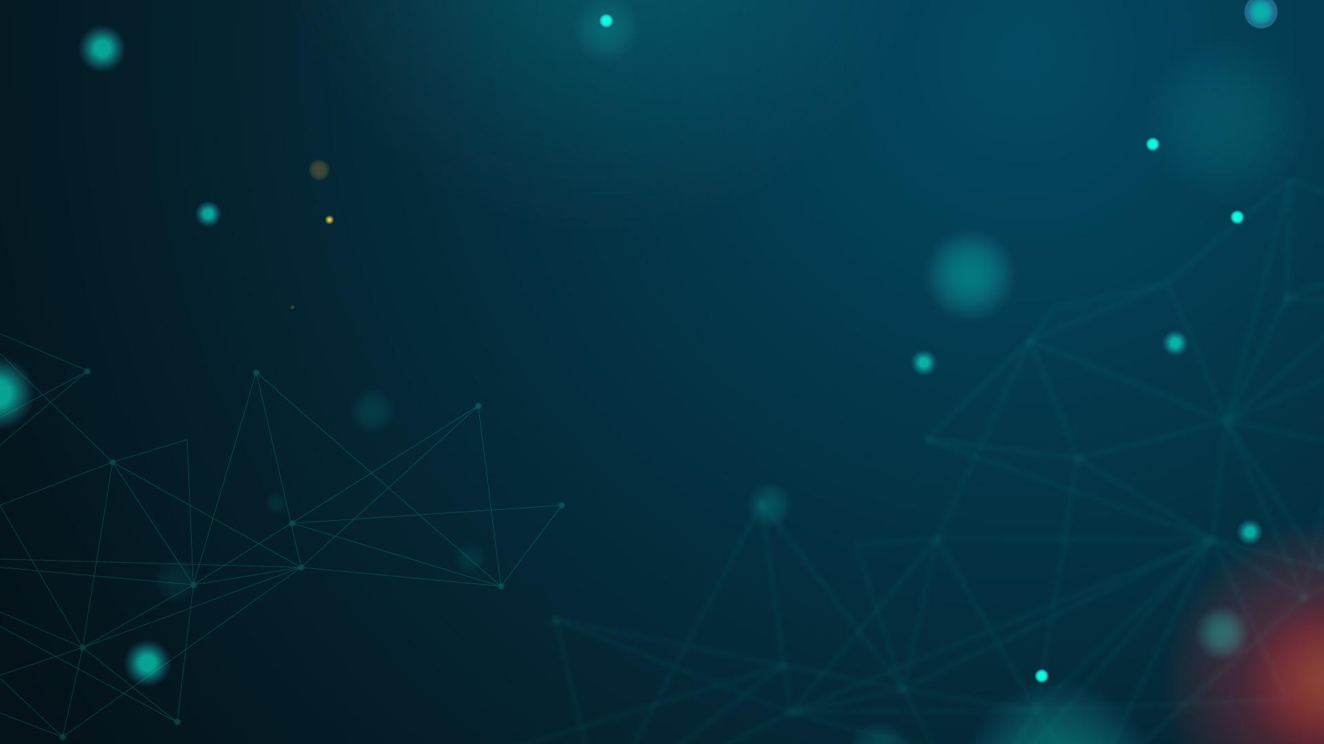
ABOUT US
OUR CLIENTS
01
03
OUR SERVICES
OUR TEAM
02
04
Here you could describe the topic of the section
Here you could describe the topic of the section
Here you could describe the topic of the section
Here you could describe the topic of the section

Slide 4
TABLE OF CONTENTS
01
02
03
ABOUT US
OUR SERVICES
OUR CLIENTS
Here you could describe the topic of the section
Here you could describe the topic of the section
Here you could describe the topic of the section

Slide 5
ABOUT
US
01
You can enter a subtitle here if you need it

Slide 6
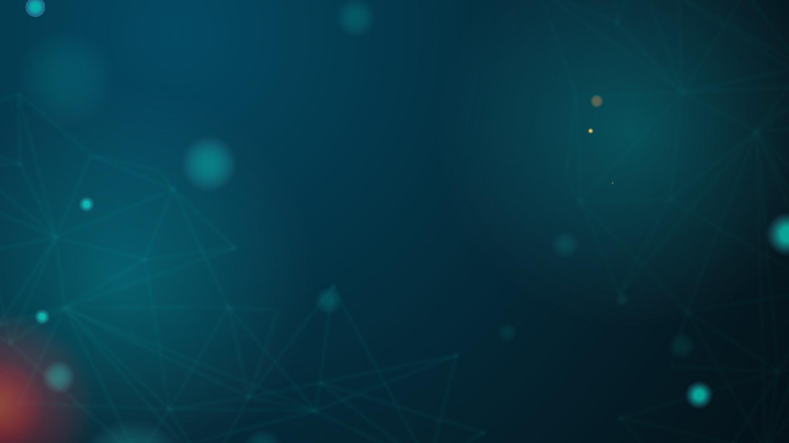
ABOUT US
Mercury is the closest planet to the Sun and the smallest one in the Solar System—it’s only a bit larger than the Moon. The planet’s name has nothing to do with the liquid metal, since it was named after the Roman messenger god, Mercury

Slide 7
ABOUT US
MERCURY
Mercury is the closest planet to the Sun and the smallest one in the Solar System—it’s only a bit larger than the Moon
VENUS
Venus has a beautiful name and is the second planet from the Sun. It’s terribly hot, even hotter than Mercury

Slide 8
OUR EVOLUTION
Jupiter is a gas giant and the biggest planet
2005
2010
Saturn is composed of hydrogen and helium
Mercury is the closest planet to the Sun
2015
2021
Despite being red, Mars is a cold place

Slide 9
OUR EVOLUTION
2008
2013
2021
MERCURY
NEPTUNE
JUPITER
Mercury is the closest planet to the Sun
Neptune is far away
from Earth
It’s the biggest planet
in the Solar System

Slide 10
WHAT SETS US APART?
MARS
NEPTUNE
VENUS
Despite being red, Mars is actually a cold place. It’s full of iron oxide dust
Neptune is the fourth-largest planet in the Solar System
Venus has a beautiful name and is the second planet from the Sun

Slide 11
MARS
WHAT SETS US APART?
NEPTUNE
VENUS
Despite being red, Mars is actually a cold place. It’s full of iron oxide dust
Neptune is the fourth-largest planet by diameter in the Solar System
Venus has a beautiful name and is the second planet from the Sun

Slide 12
02
OUR SERVICES
You can enter a subtitle here if you need it

Slide 13
WHAT DO WE DO?
Mercury is the smallest planet in the Solar System
Venus has a beautiful name, but it’s terribly hot
Jupiter is the biggest planet in the Solar System
Saturn is composed of hydrogen and helium

Slide 14
WHAT DO WE DO?
MERCURY
JUPITER
SATURN
VENUS
Mercury is the smallest planet in the Solar System
Jupiter is the biggest planet in the Solar System
Saturn is the
ringed planet and a gas giant
Venus has a beautiful name, but it’s terribly hot

Slide 15
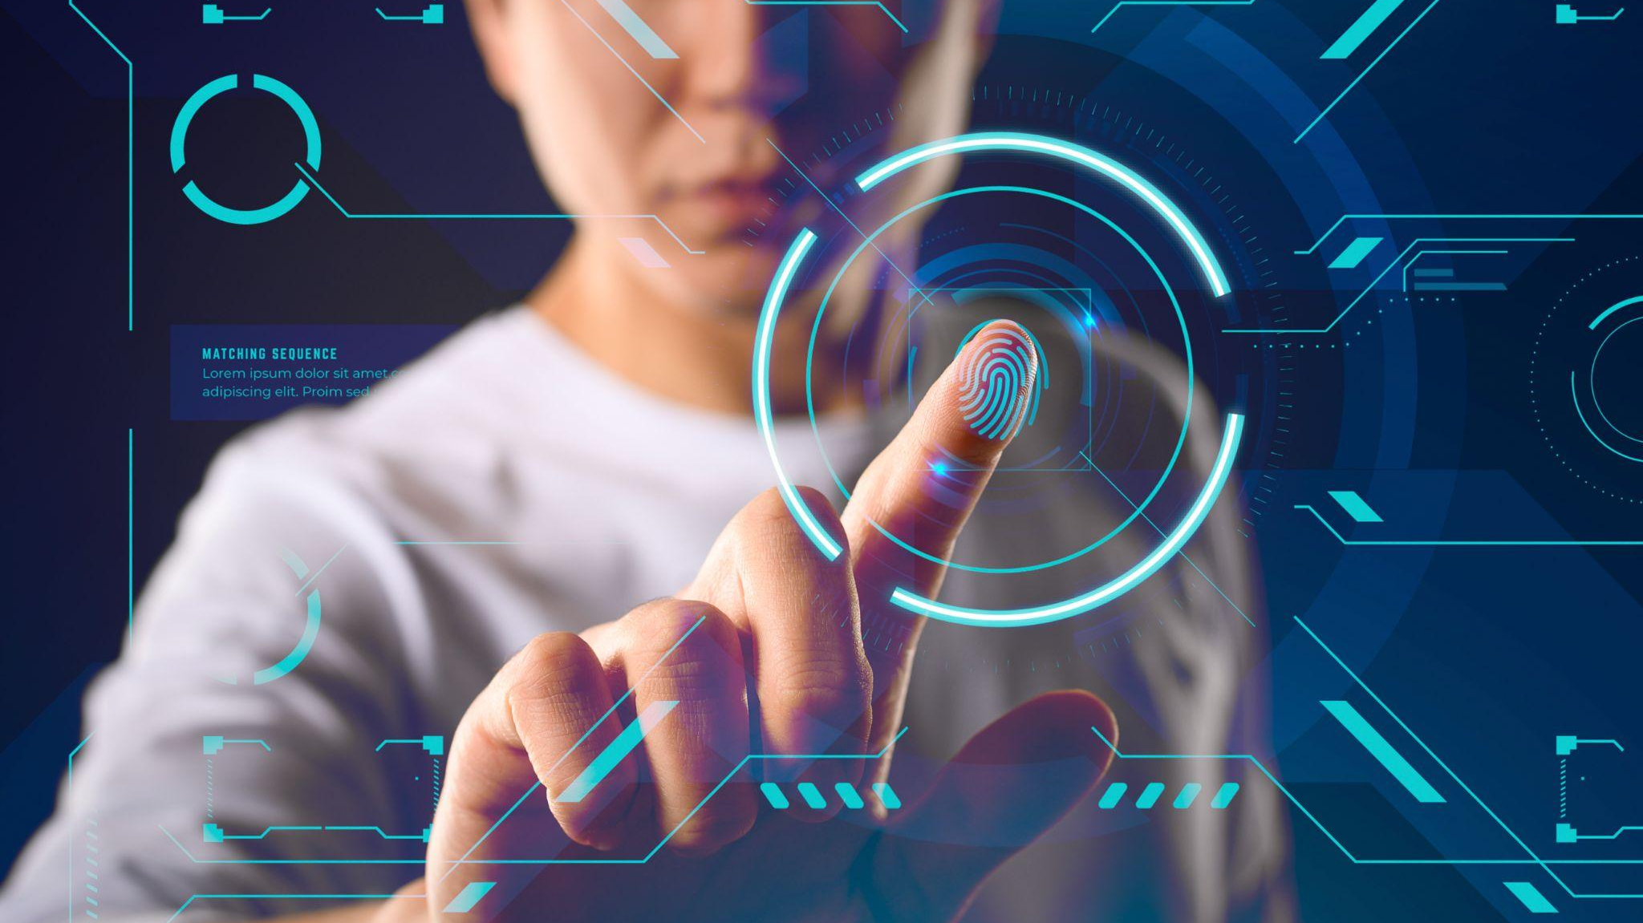
A PICTURE IS WORTH THOUSAND WORDS

Slide 16
HOW DO WE DO IT?
VENUS
Venus has a beautiful name, but it’s terribly hot
MERCURY
Mercury is the smallest planet in the Solar System
SATURN
Saturn is composed of hydrogen and helium

Slide 17
INFOGRAPHIC
MARS
MERCURY
NEPTUNE
Despite being red, Mars is actually a cold place
Mercury is the closest planet to the Sun
Neptune is the farthest planet from the Sun

Slide 18
INFOGRAPHIC
MERCURY
SATURN
Mercury is the smallest planet in the Solar System
Saturn is composed of hydrogen and helium

Slide 19
INFOGRAPHICS
Neptune is the farthest planet from the Sun
Mercury is the closest planet to the Sun
Saturn is the ringed planet and a gas giant
Mars is the fourth planet from the Sun

Slide 20
INFOGRAPHICS
VENUS
Venus has a beautiful name, but it’s terribly hot
SATURN
Saturn is composed of hydrogen and helium

Slide 21
HOW DO WE DO IT?
MERCURY
VENUS
Mercury is the smallest planet in the Solar System
Venus has a beautiful name, but it’s terribly hot
JUPITER
SATURN
Jupiter is the biggest planet in the Solar System
Saturn is composed of hydrogen and helium

Slide 22
TIMELINE
1
MARS
Despite being red, Mars is actually a cold place
2
MERCURY
Mercury is the smallest planet in the Solar System
3
NEPTUNE
Neptune is the farthest planet from the Sun

Slide 23
WHAT DO WE OFFER?
01 | 02 | 03 | 04
Mercury is the smallest planet in the Solar System | Jupiter is the biggest planet in the entire Solar System | Venus has a beautiful name, but it’s terribly hot | Saturn is composed of hydrogen and also helium

Slide 24
WHAT DO WE OFFER?
01
MERCURY
Mercury is the smallest planet in the Solar System
02
SATURN
Saturn is composed of hydrogen and helium
03
JUPITER
Jupiter is the biggest planet in the Solar System
04
VENUS
Venus has a beautiful name, but it’s terribly hot

Slide 25
WHAT DO WE OFFER?
MARS
45%
NEPTUNE
60%
JUPITER
30%
SATURN
78%

Slide 26
THIS IS A TABLE
STAGE
DESCRIPTION
MARS |  | Despite being red, Mars is actually a cold place
MERCURY |  | Mercury is the smallest planet in the Solar System
VENUS |  | Venus has a beautiful name, but it’s terribly hot

Slide 27
TIMELINE
DAY 1
DAY 2
DAY 3
MERCURY
JUPITER
VENUS
Mercury is the closest planet to the Sun
It’s the biggest planet in the Solar System
Venus has a beautiful name, but it’s hot

Slide 28
03
OUR CLIENTS
You can enter a subtitle here if you need it

Slide 29
OUR CLIENTS
Mercury is the smallest planet in the Solar System
Venus has a beautiful name, but it’s terribly hot
MERCURY
VENUS
JUPITER
SATURN
Jupiter is the biggest planet in the Solar System
Saturn is composed of hydrogen and helium

Slide 30
OUR CLIENTS AROUND THE WORLD
MERCURY
Mercury is the smallest planet in the Solar System
JUPITER
Jupiter is the biggest planet in the Solar System

Slide 31
22M
4,500
Mercury is the smallest planet in the Solar System
Despite being red, Mars is actually a cold place

Slide 32
THIS IS A DIAGRAM
1
2021
Mercury is the closest planet to the Sun
EVENTS
2
2022
It’s the biggest planet in the Solar System
3
2023
Venus has a beautiful name, but it’s hot

Slide 33
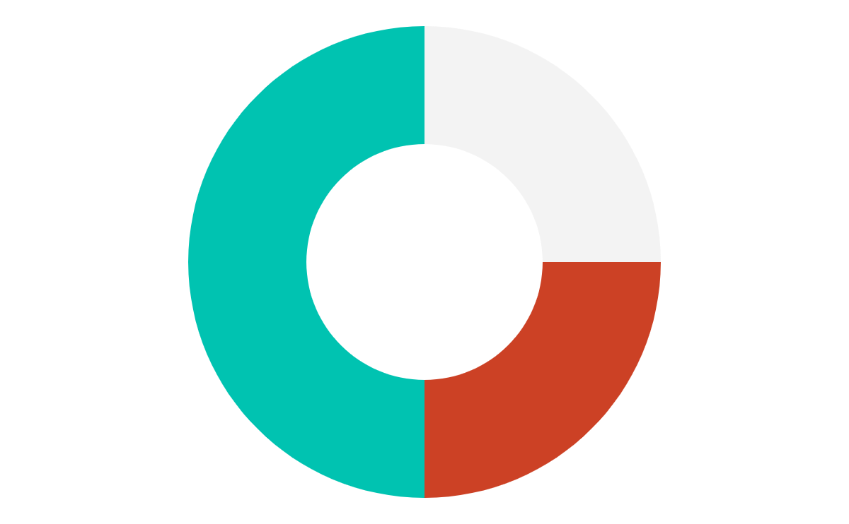
OUR TARGET
VENUS 25%
MERCURY 50%
MARS 25%
Venus has a beautiful name, but it’s terribly hot
Mercury is the closest planet to the Sun
Despite being red, Mars is actually a cold place
To modify this graph, click on it, follow the link, change the data and paste the resulting graph here

Slide 34
WHAT DO THEY SAY ABOUT US?
MARS
VENUS
MERCURY
NEPTUNE
SATURN
JUPITER
Despite being red, Mars is actually a cold place
Venus has a beautiful name, but it’s terribly hot
Mercury is the closest planet to the Sun
Neptune is the farthest planet from the Sun
Saturn is composed of hydrogen and helium
Jupiter is the biggest planet in the Solar System

Slide 35
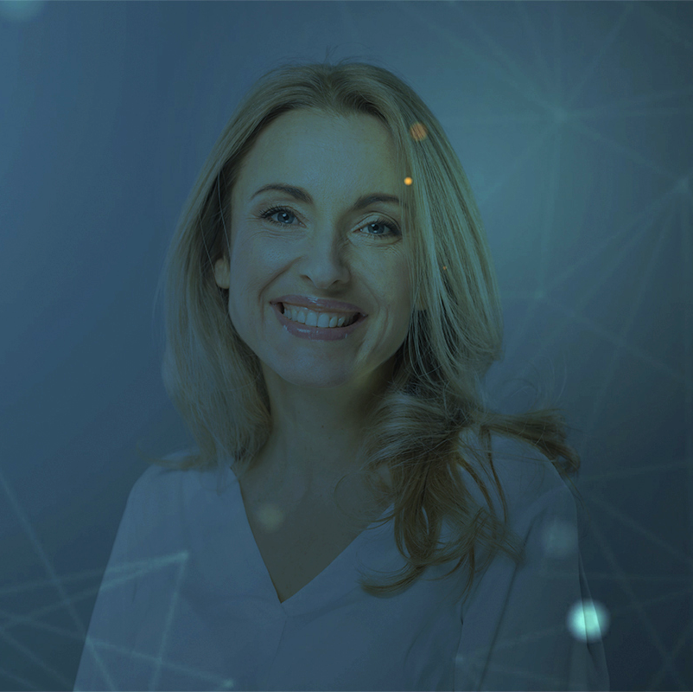
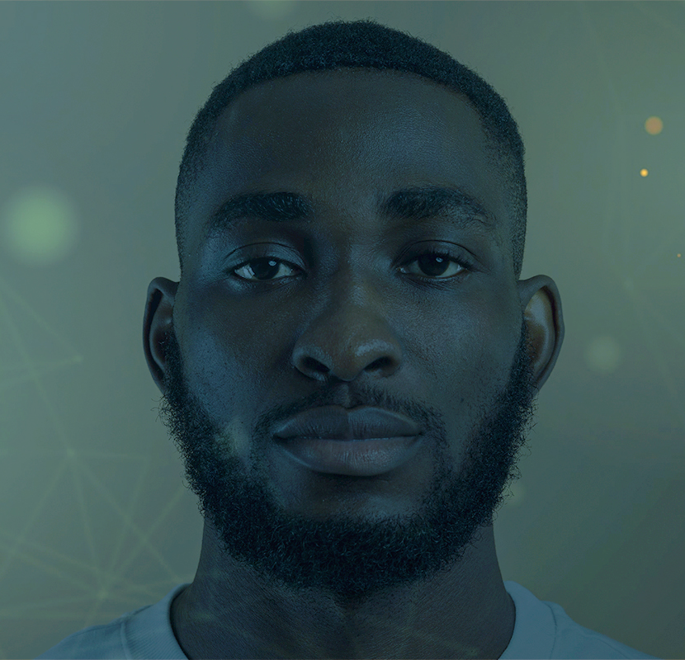
WHAT DO THEY SAY ABOUT US?
JENNA DOE, 36
“Jupiter is the biggest planet in the Solar System”
JOHN JAMES, 24
“Neptune is the farthest planet from the Sun”

Slide 36
—SOMEONE FAMOUS
“This is a quote, words full of wisdom that someone important said and can make the reader get inspired”

Slide 37
CASE STUDIES
Venus is the second planet from the Sun
Saturn is the ringed planet and a gas giant
VENUS
SATURN
MARS
MERCURY
NEPTUNE
Despite being red, Mars is actually a cold place
Mercury is the closest planet to the Sun
Neptune is the farthest planet from the Sun

Slide 38
CASE STUDIES
MERCURY
NEPTUNE
VENUS
SATURN
MARS
JUPITER
Mercury is the closest planet to the Sun
Neptune is the farthest planet from the Sun
Venus has a beautiful name, but it’s terribly hot
Saturn is composed of hydrogen and helium
Despite being red, Mars is actually a cold place
Jupiter is the biggest planet in the Solar System

Slide 39
CASE STUDIES
JUPITER | NEPTUNE
It’s the fifth planet It’s the largest planet It’s a gas giant It’s named after a god | It’s the eighth planet It’s the densest planet It’s an ice giant It’s very far away

Slide 40
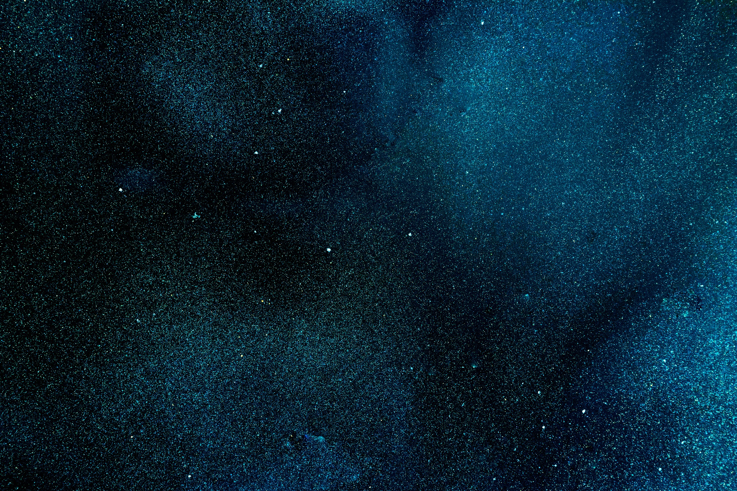
AWESOME WORDS

Slide 41
AWESOME WORDS

Slide 42
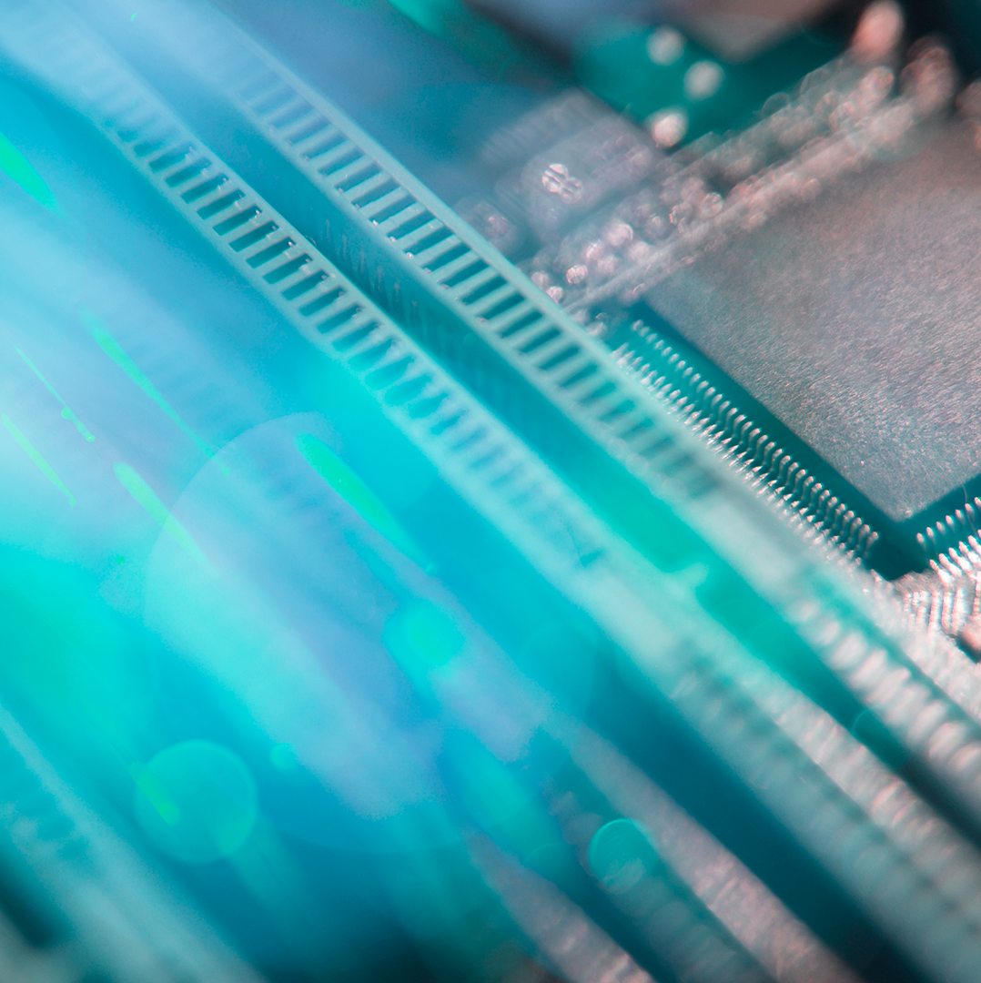
A PICTURE ALWAYS REINFORCES THE CONCEPT

Slide 43

A PICTURE IS
ALWAYS REINFORCES THE CONCEPT
Images reveal large amounts of data, so remember: use an image instead of a long text

Slide 44
333,000,000+
connectors has the most complex AI prototype

Slide 45
4,650,000
connectors has the most complex AI prototype

Slide 46
COUNTRIES WHERE IT’S BEING IMPLEMENTED
30%
70%
Despite being red, Mars is actually cold
Mercury is the closest planet to the Sun

Slide 47
PLACES WHERE IT’S BEING IMPLEMENTED
MERCURY
Mercury is the closest planet to the Sun and the smallest one in the Solar System

Slide 48
333,000.000
24h 37m 23s
386,000km
Earths is the Sun’s mass
Is Jupiter’s rotation period
This is a long distance

Slide 49
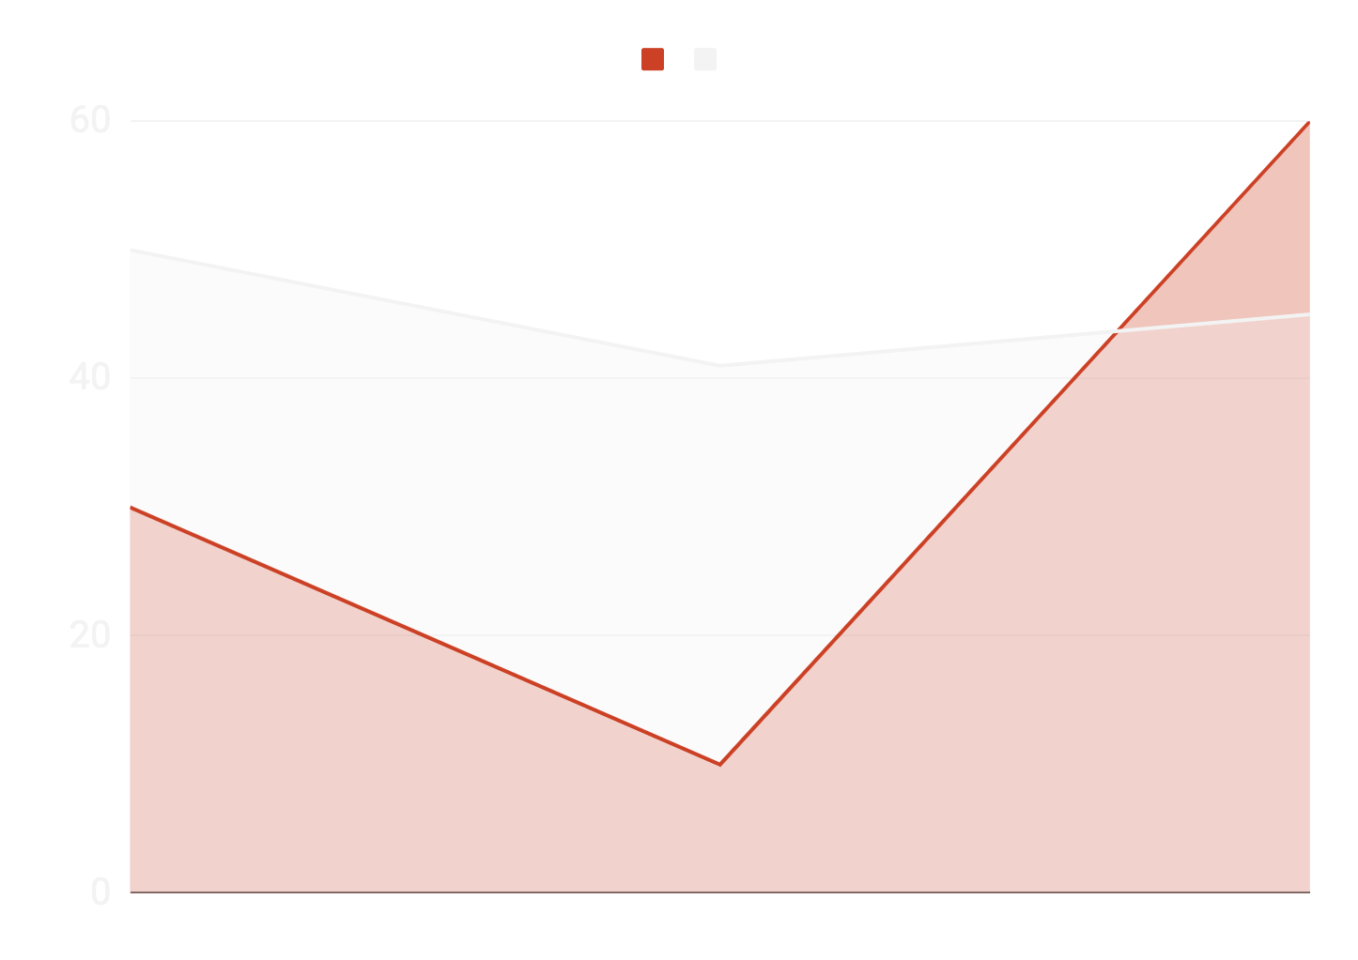
OUR GROWTH
Jupiter is a gas giant and the biggest planet
Mercury is the closest planet to the Sun
To modify this graph, click on it, follow the link, change the data and paste the new graph here

Slide 50
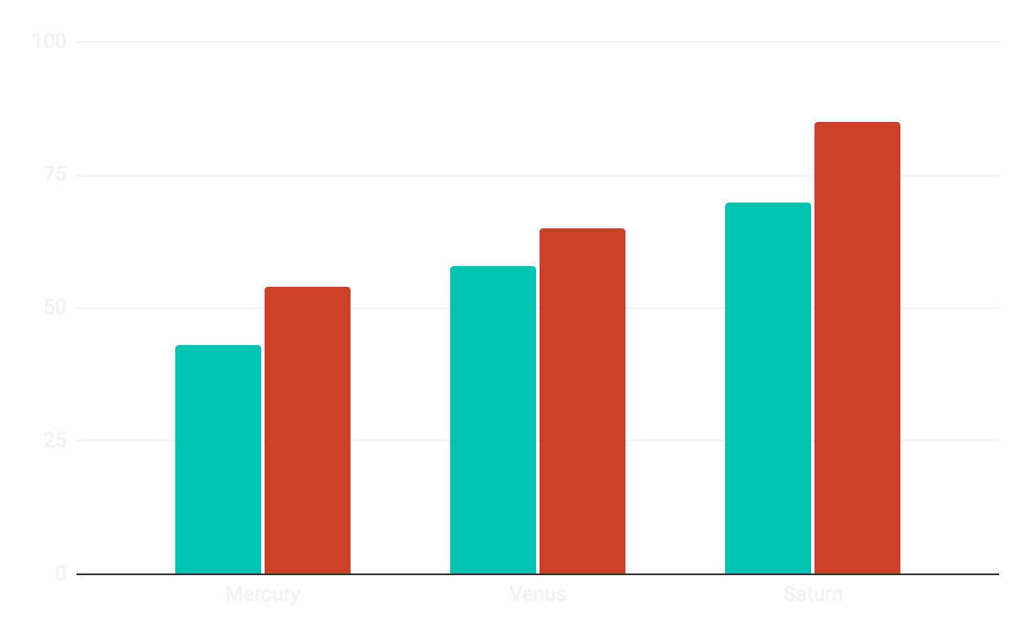
OUR GROWTH
NEPTUNE
Neptune is the farthest planet from the Sun
JUPITER
It’s the biggest planet in the Solar System
To modify this graph, click on it, follow the link, change the data and paste the resulting graph here

Slide 51
OUR PROGRESS
NEPTUNE
VENUS
Neptune is the farthest planet from the Sun
Venus is the second planet from the Sun
MERCURY
MARS
Mercury is the closest planet to the Sun
Despite being red, Mars is actually a cold place

Slide 52
OUR PROGRESS
25%
45%
60%
MERCURY
VENUS
JUPITER
Mercury is the closest planet to the Sun
Venus is the second planet from the Sun
It’s the biggest planet in the Solar System

Slide 53
HERE ARE SOME PERCENTAGES
45%
80%
SATURN
MARS
Saturn is the ringed planet and a gas giant
Despite being red, Mars is actually a cold place

Slide 54
CALENDAR
JAN
FEB
MAR
APR
MAY
JUN
Phase 1
Task 1
Phase 2
Task 1

Slide 55
THE SLIDE TITLE GOES HERE!
Do you know what helps you make your point clear? Lists like this:
They’re simple
You can organize your ideas clearly
You’ll never forget to buy milk!
And the audience won’t miss the point of your presentation

Slide 56
MEET THE TEAM
HELENA JAMES
JESSICA DOE
JOHN PATTERSON
You can replace the image on the screen with your own
You can replace the image on the screen with your own
You can replace the image on the screen with your own

Slide 57
MEET THE TEAM
JENNA DOE
JAMES PATTERSON
You can replace the image on the screen with your own
You can replace the image on the screen with your own

Slide 58
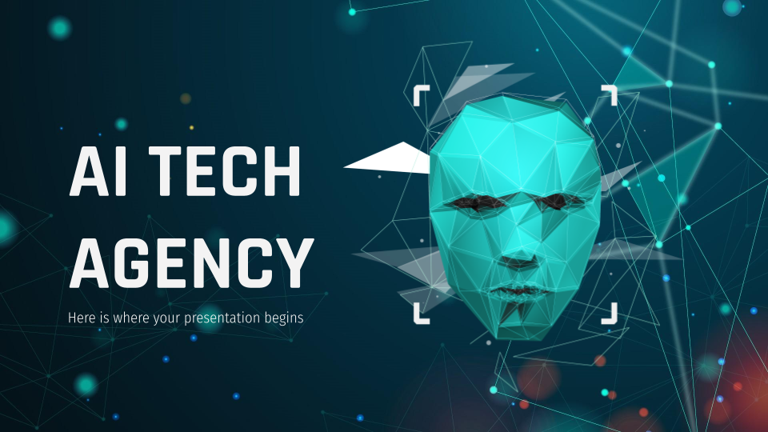
SOFTWARE DESKTOP
Mercury is the closest planet to the Sun and the smallest one in the Solar System—it’s only a bit larger than the Moon

Slide 59
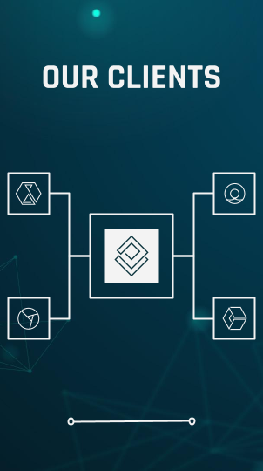
MOBILE WEB
Venus has a beautiful name and is the second planet from the Sun. It’s terribly hot and its atmosphere is extremely poisonous

Slide 60
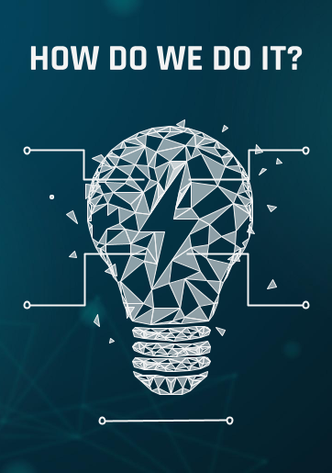
TABLET APP
Despite being red, Mars is a cold place, not hot. It’s full of iron oxide dust, which gives the planet its reddish cast

Slide 61
THANKS!
Do you have any questions?
youremail@freepik.com
+00 000 000 000
yourcompany.com
Please keep this slide for attribution.

